Slide 1
PROGRESS REPORT ON THE JOSENHANS TRAINING CENTRE BANA, MANYAKPONGUNOR, GHANA
On-going works

Slide 2
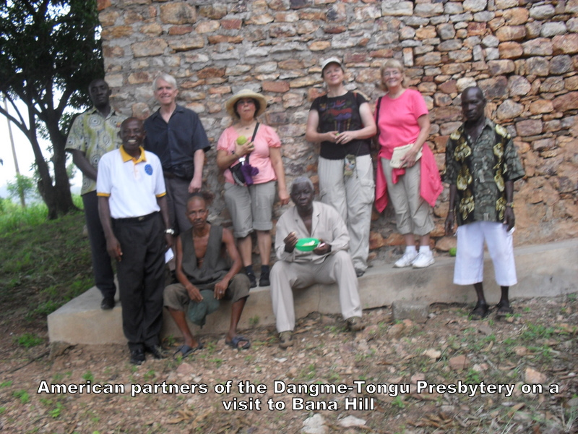
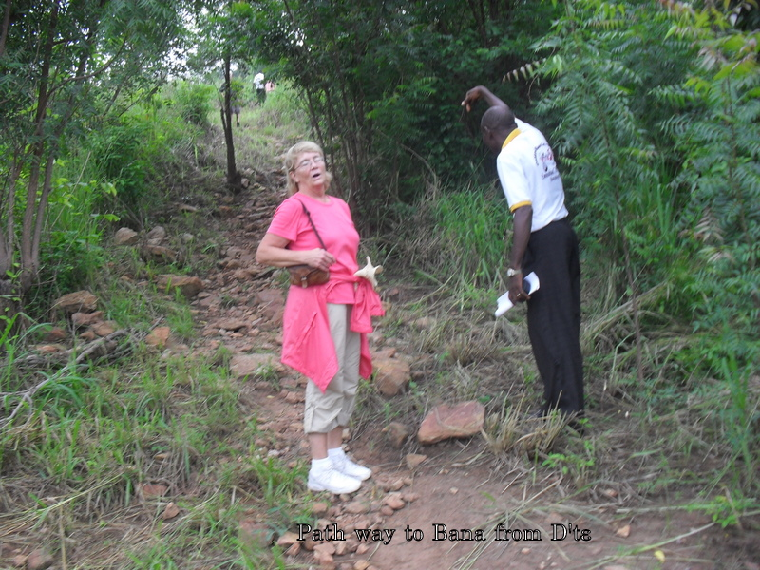
Milwaukie Partners visit to Bana

Slide 3
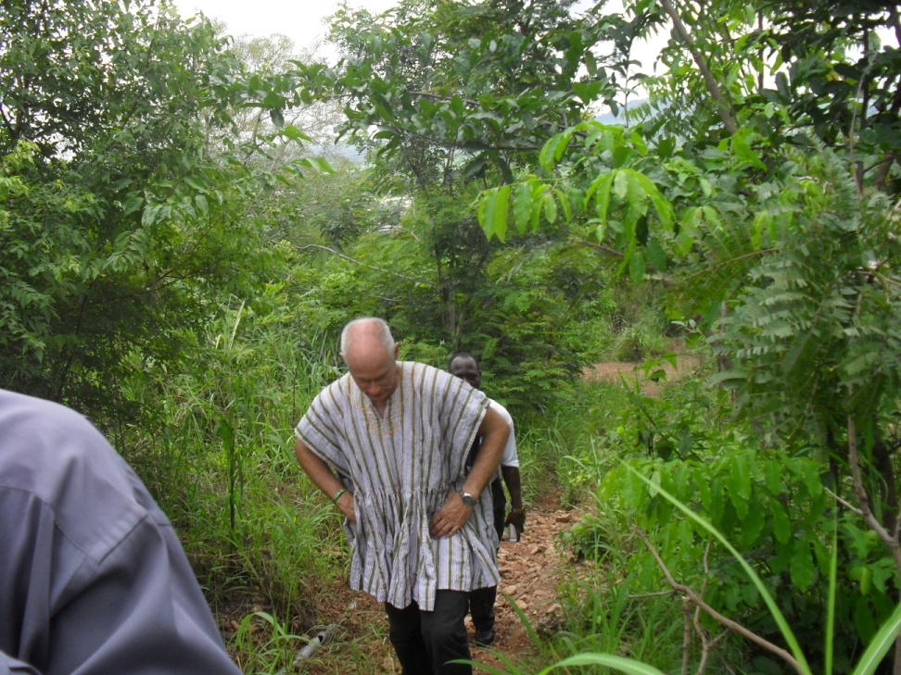
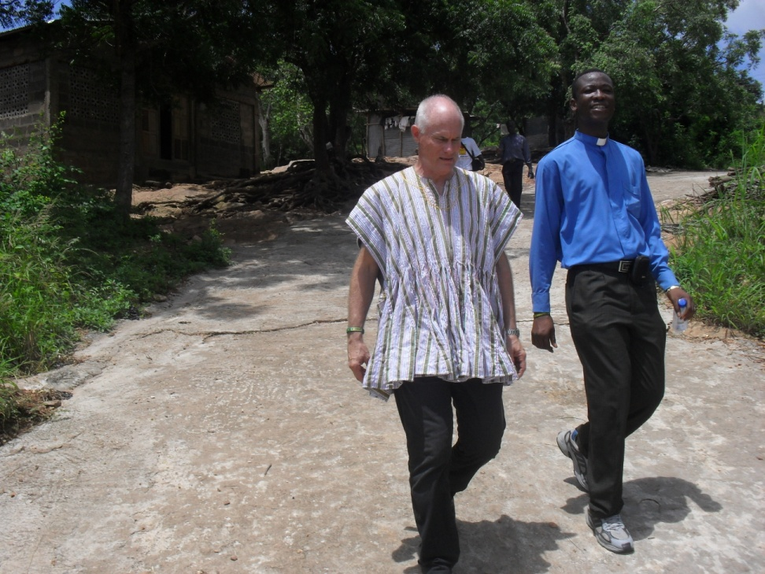
Ryle Edward’s Visit
Ryle Edwards climbing to Bana
Ryle Edwards descending from Bana. This is the only concrete paved portion and the only good portion of the entire road by the time of Ryle’s visit.

Slide 4
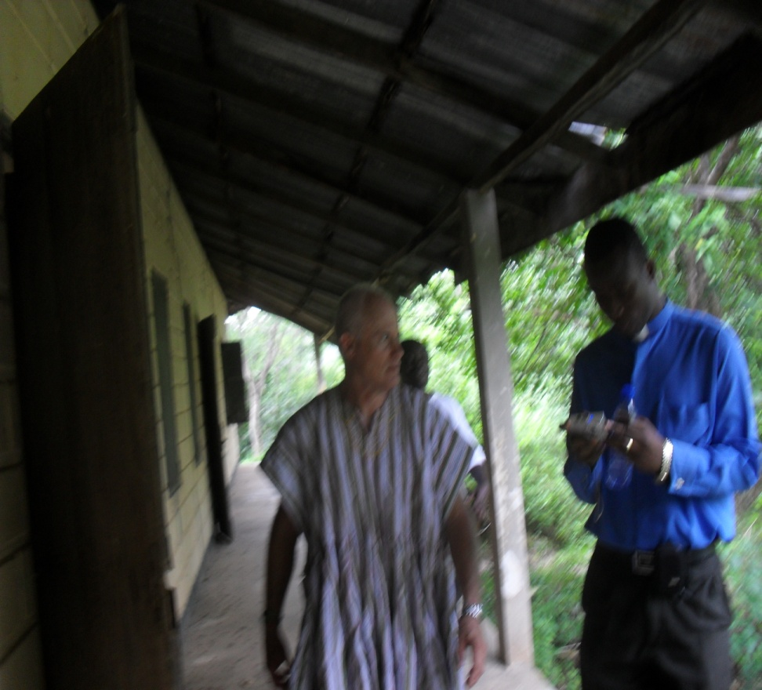
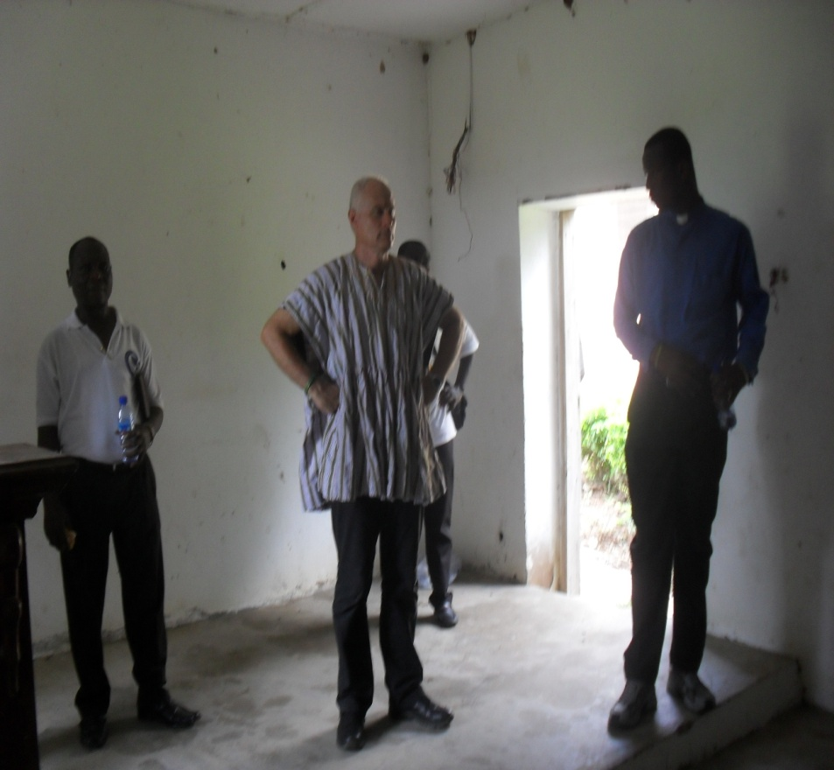
Edwards at Bana
Edwards with the Manyakpongunor District Minister Rev. Seth Adzokatse in Bana
Edwards in Bana Chapel

Slide 5
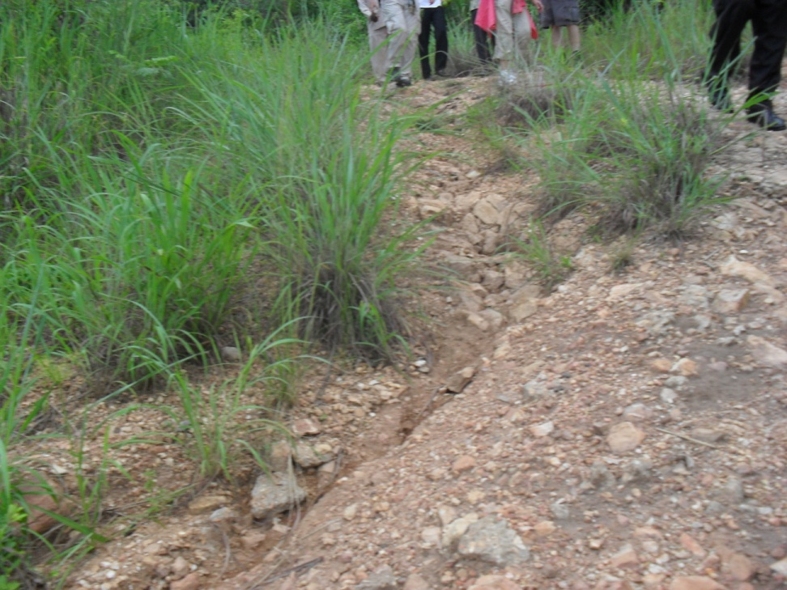
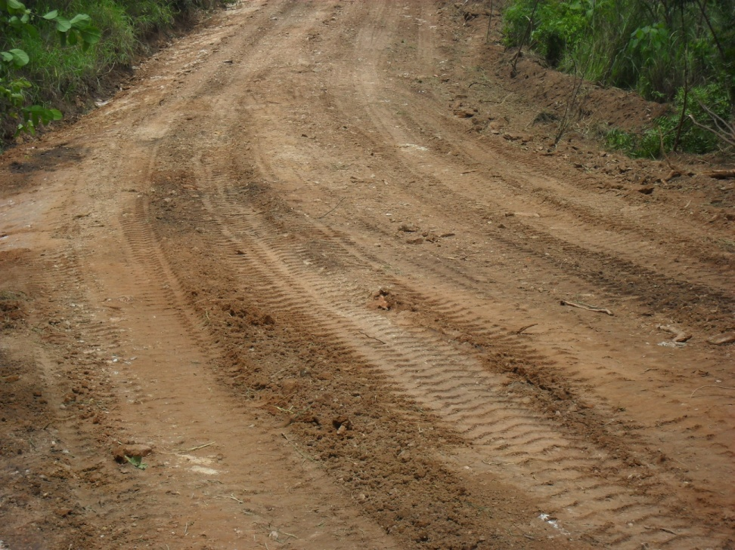
ROAD CONDITION
Condition of Road after October. A Grader and a Roller were hired to grade the road on 19th October 2011
Road condition before October 2011

Slide 6
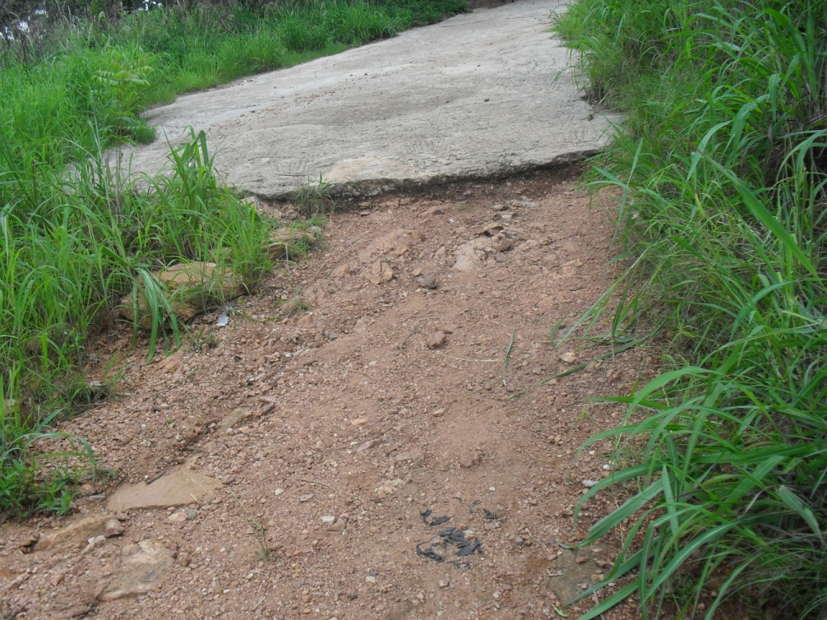
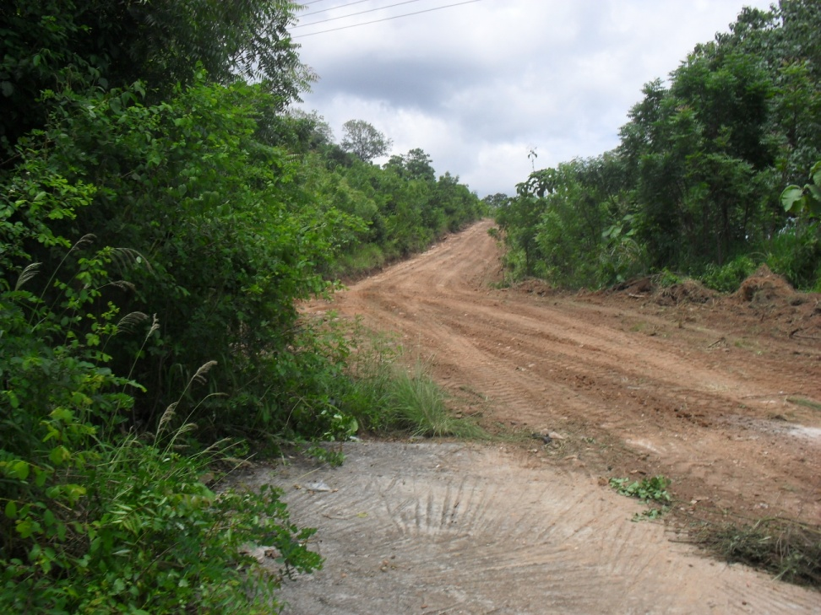
A Look of Another Portion
One of the worst portions of the road previously
As it is now after grading

Slide 7
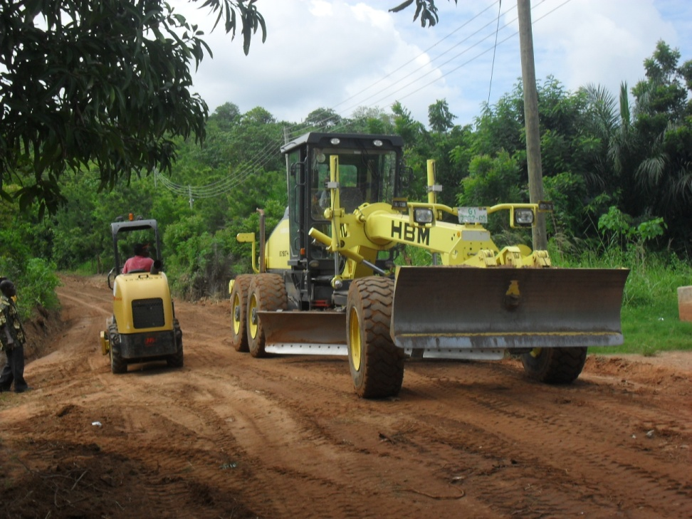
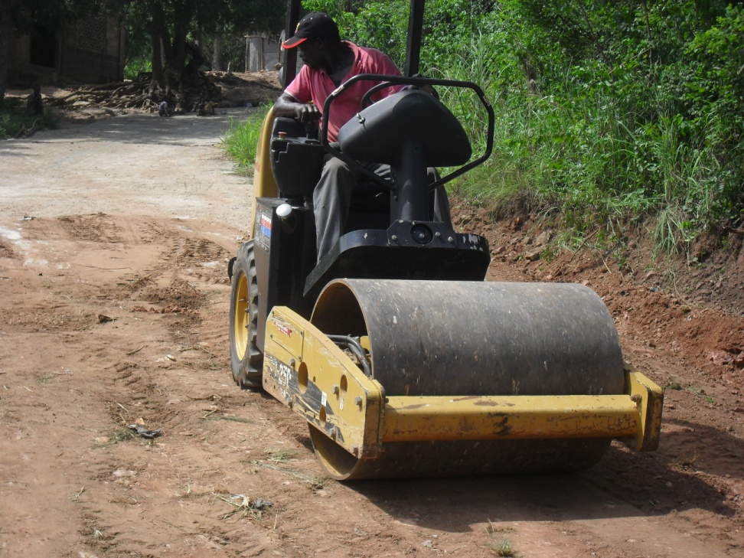
Work in Progress on Road on 19th Oct. 2011

Slide 8
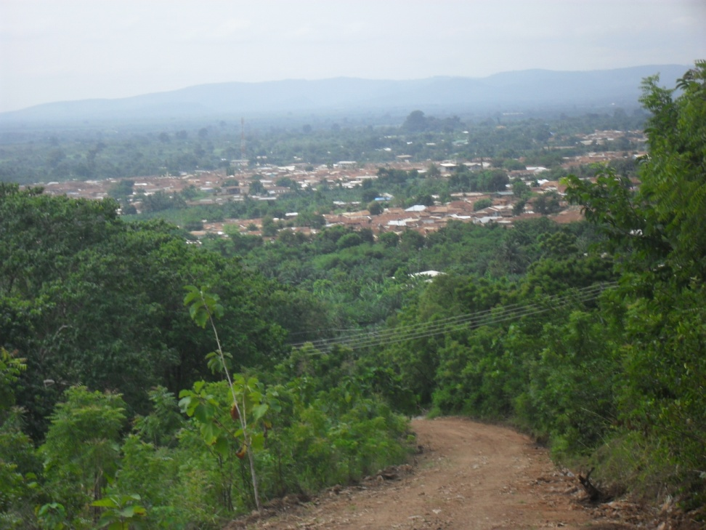
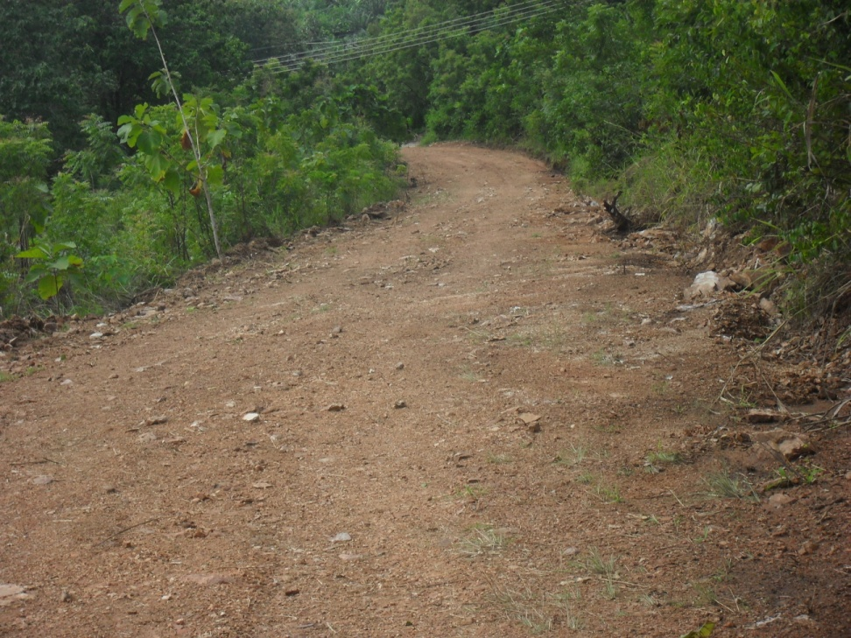
The road after it has been worked on
Graded road
Another look of Graded road

Slide 9
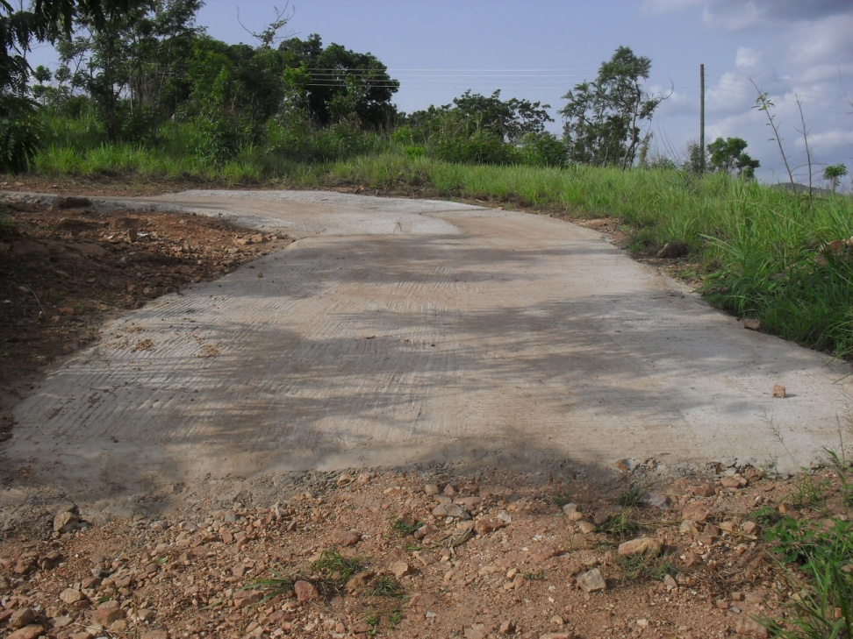
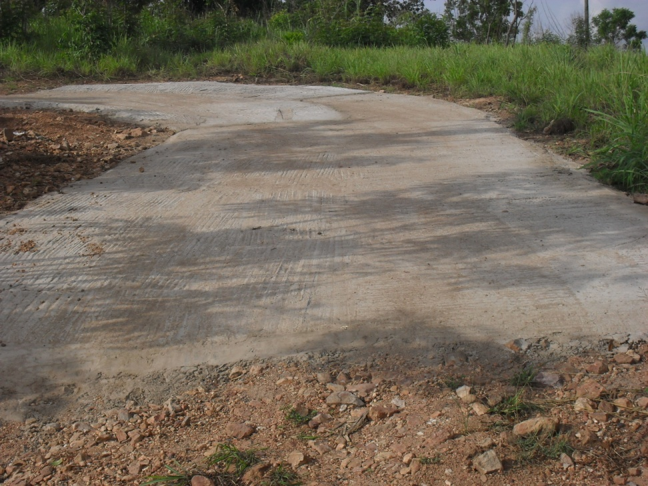
Pavement of portions of road
We are working on these portions with concrete pavement to make it more convenient for vehicles.
Some portions of the road have become slippery for vehicles

Slide 10
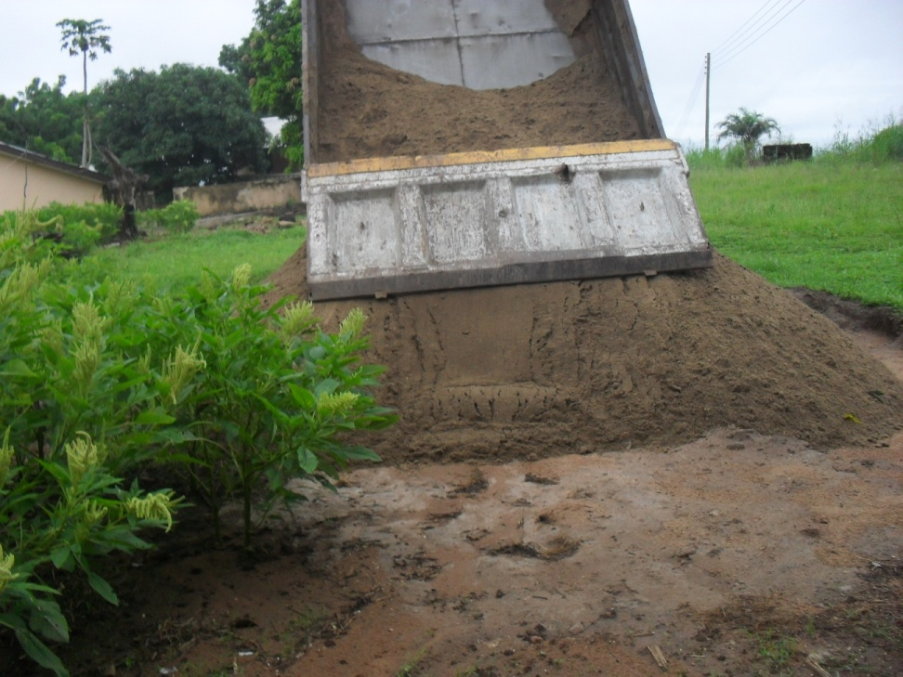
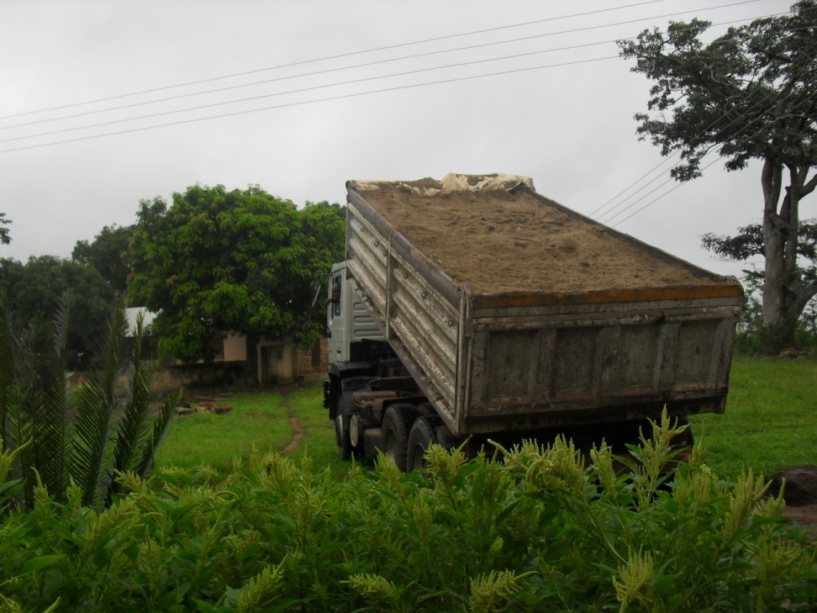
A Tipper Truck Tipping Sand at Bana after the road was Graded on 27th Oct. 2011

Slide 11
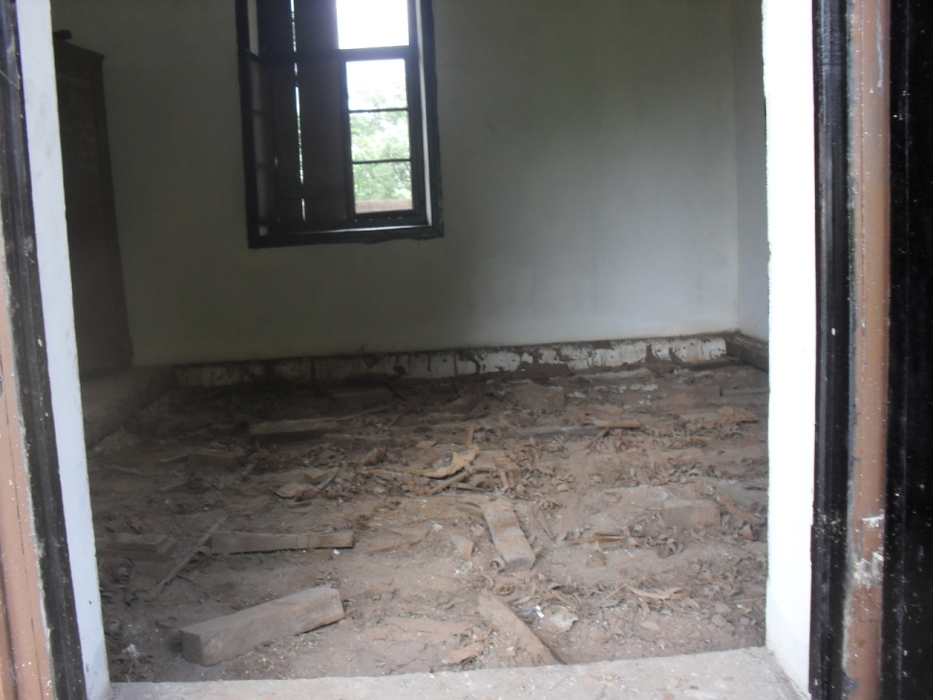
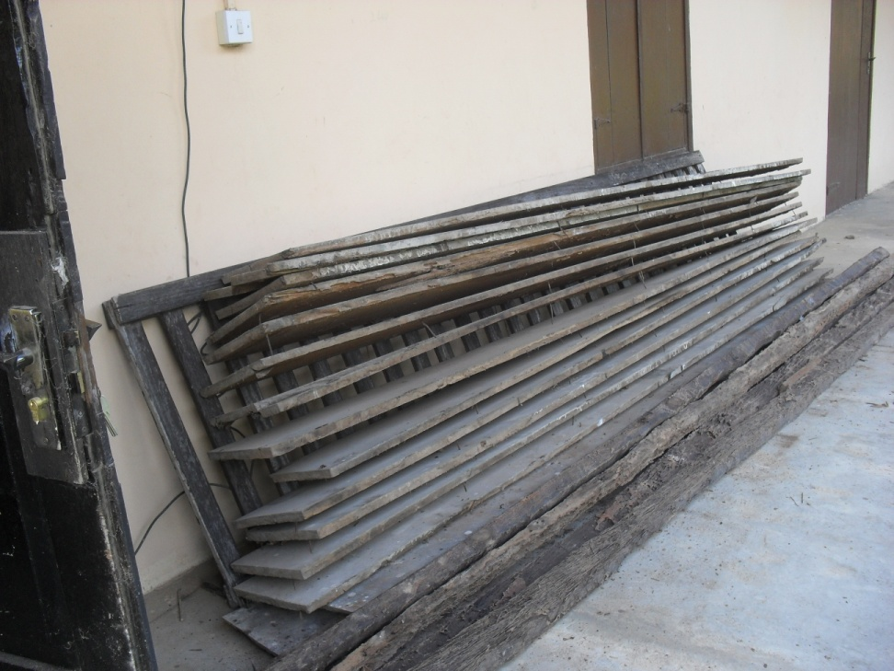
Wooden Paneling of Office Floor Removed for tiling

Slide 12
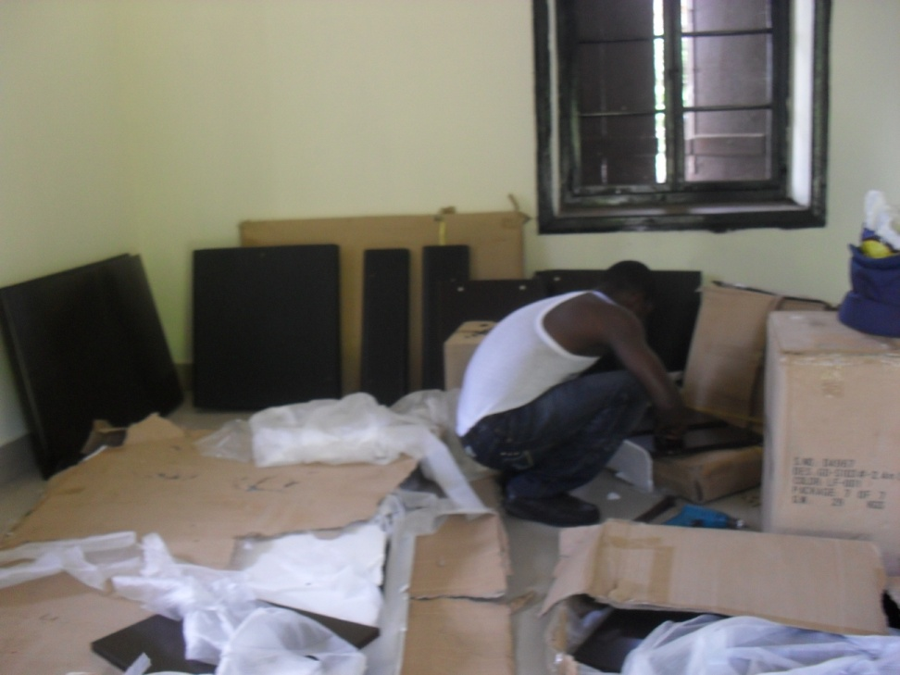
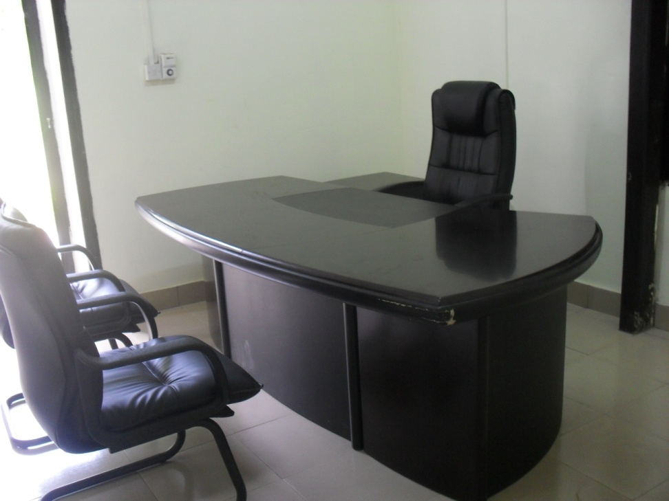
Office now tiled and furnished
Workman fixing furniture in Director's Office
The Director’s Office as it looks now

Slide 13
Construction of septic tank, tiling of rooms & paving of compound
Work at the Director’s Home

Slide 14
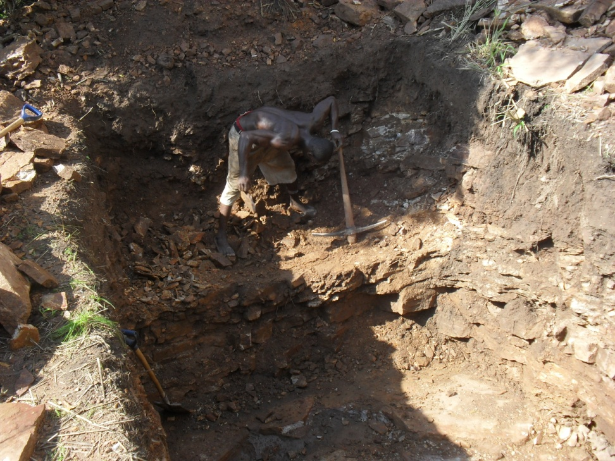
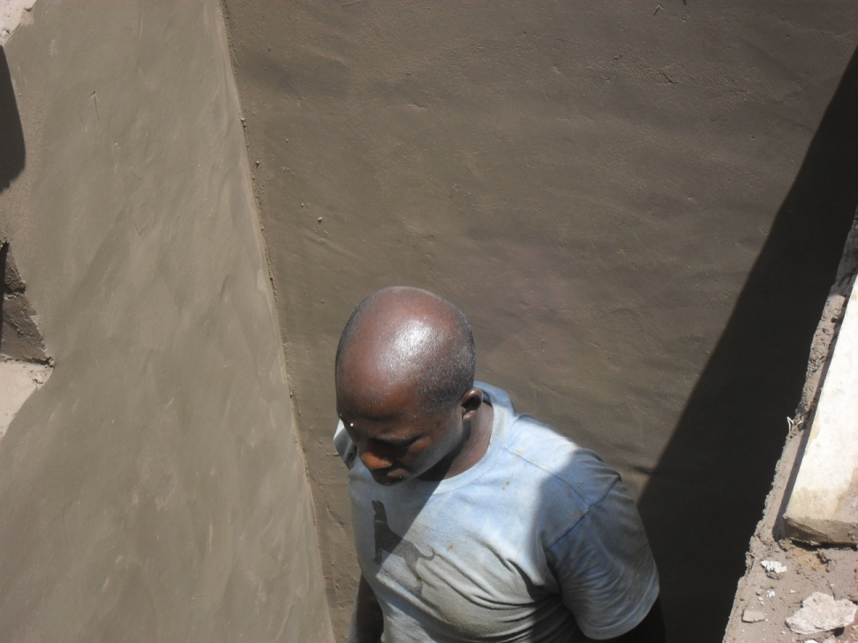
Construction of Septic tank in Director’s home
Workmen dgging trench for the septic tank in the Director’s home
Block & cement work on the septic tank

Slide 15
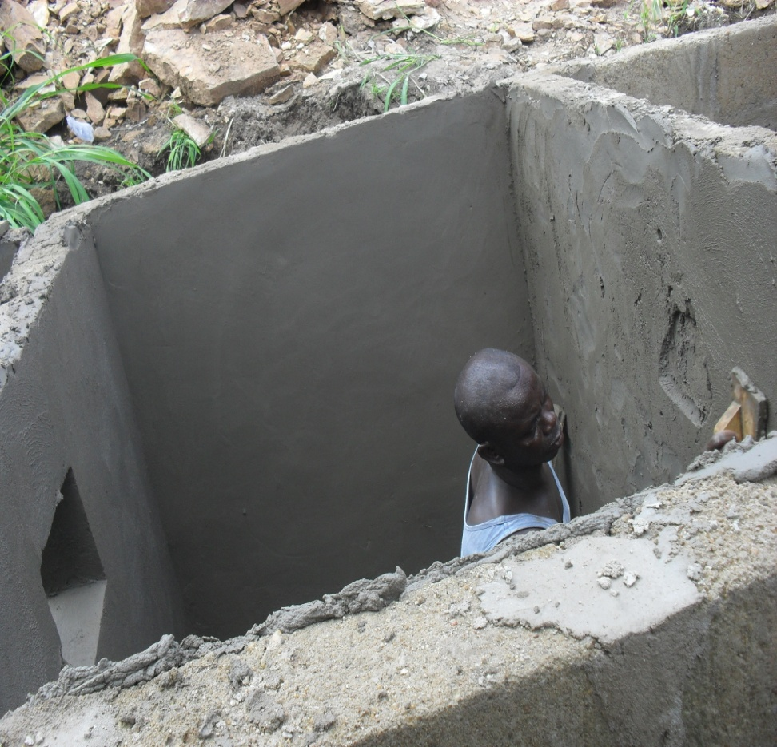
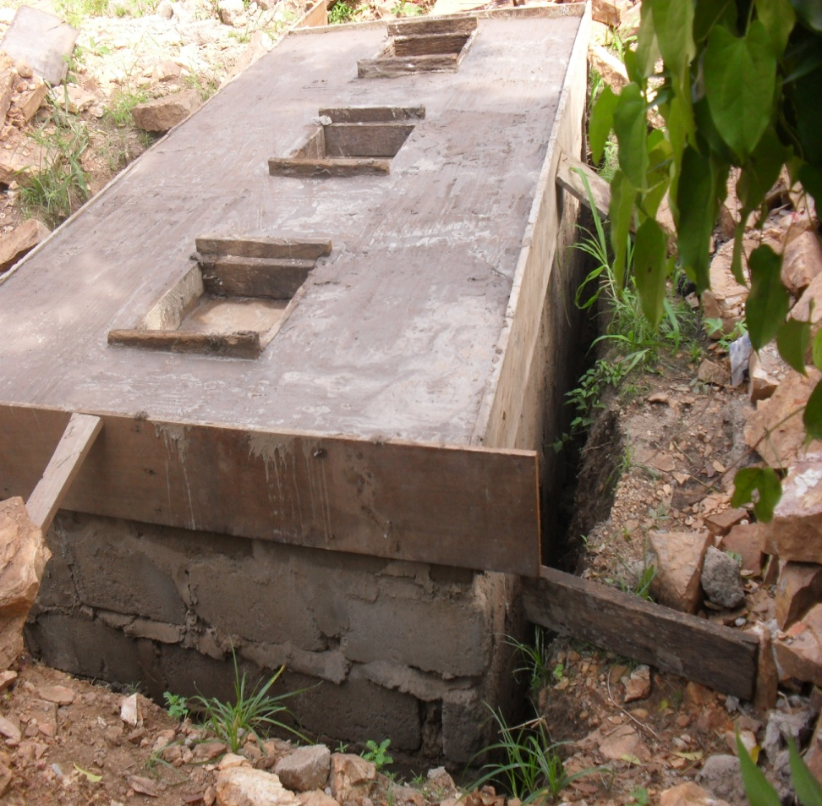
Another Stage of the Septic Tank

Slide 16
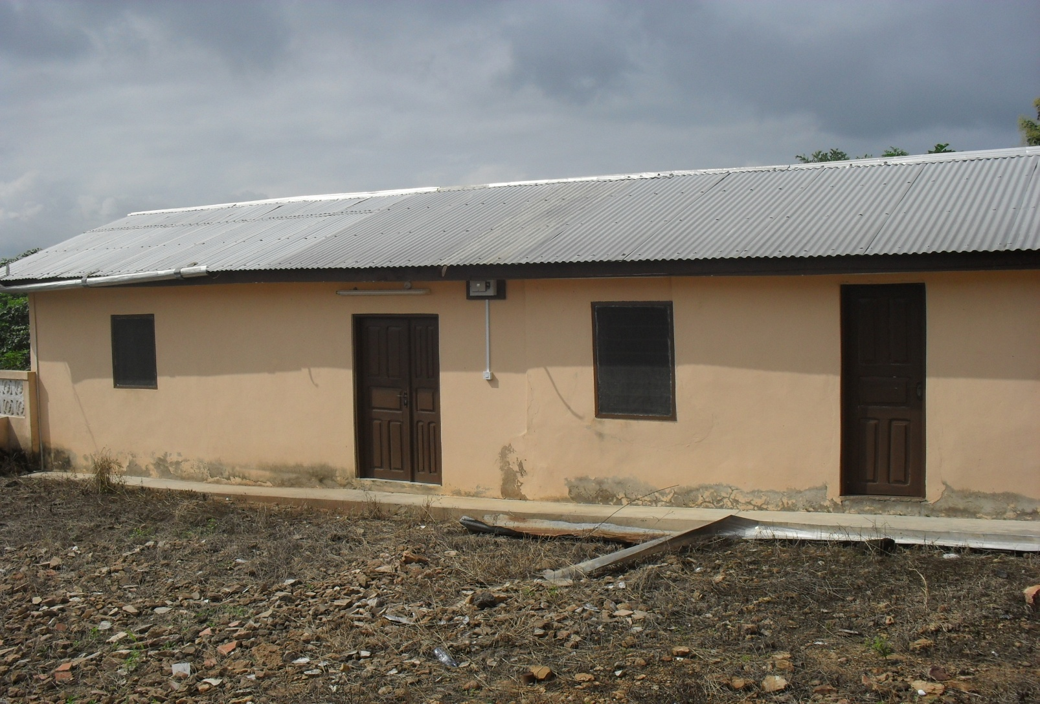
The compound of the Director’s Home before Flooring

Slide 17
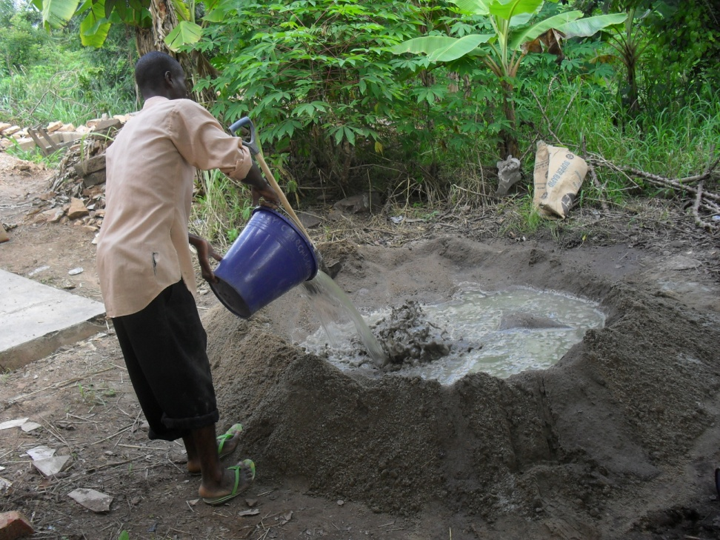
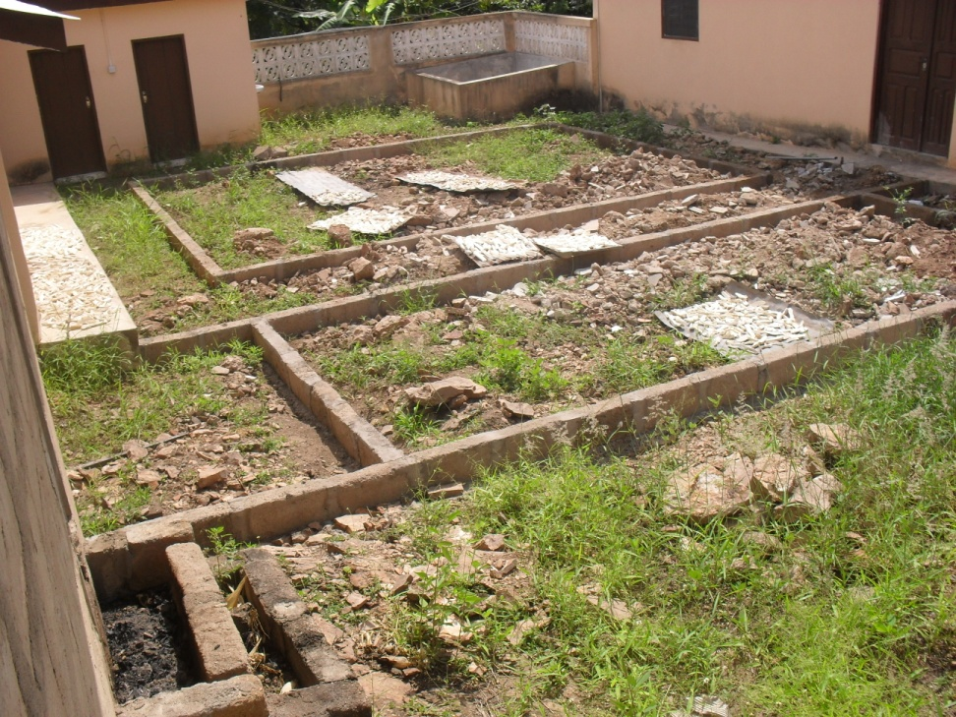
flooring of the Director’s Compound
Workmen preparing concrete for flooring the Director’s Compound
The early stages of the compound flooring work

Slide 18
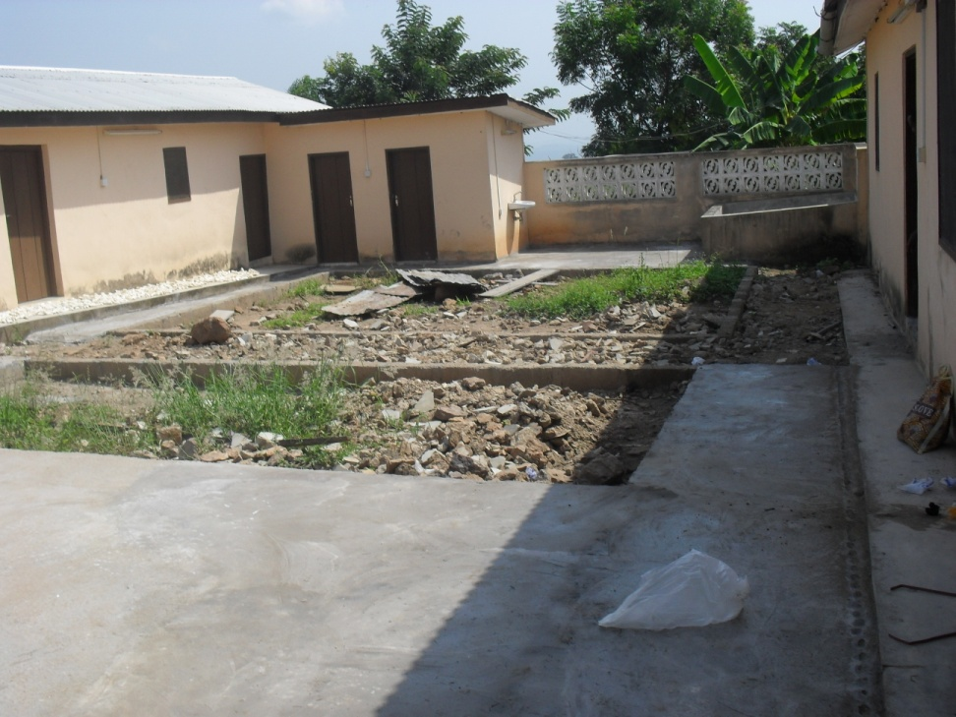
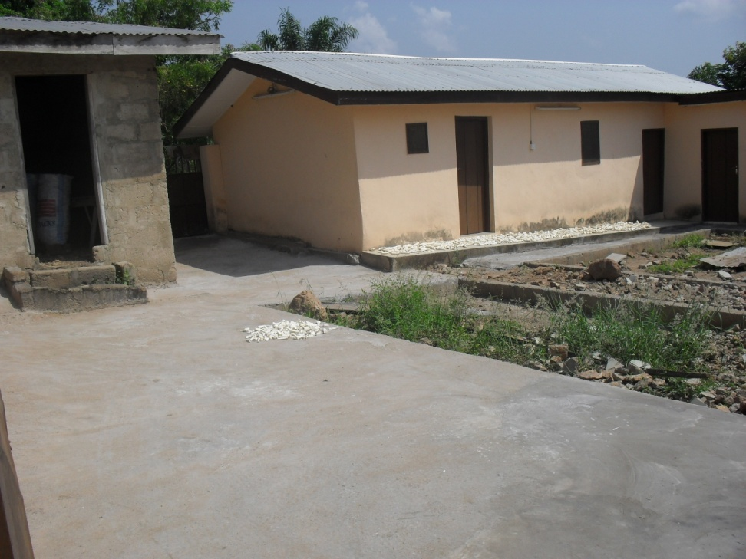
Compound Flooring
Another stage of the flooring
Two lawns have been made within the compound

Slide 19
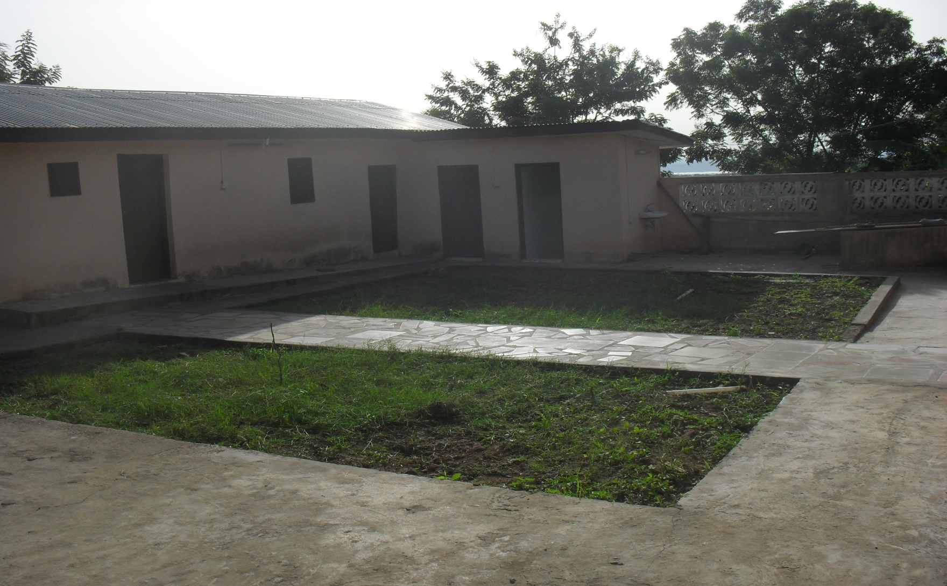
The Finished Flooring

Slide 20
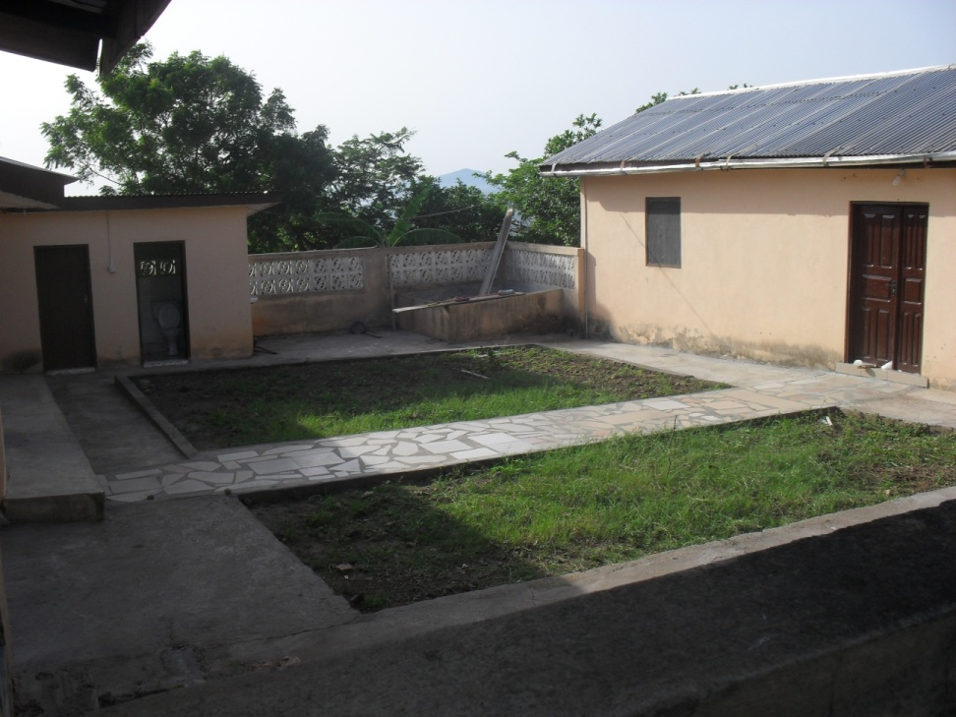
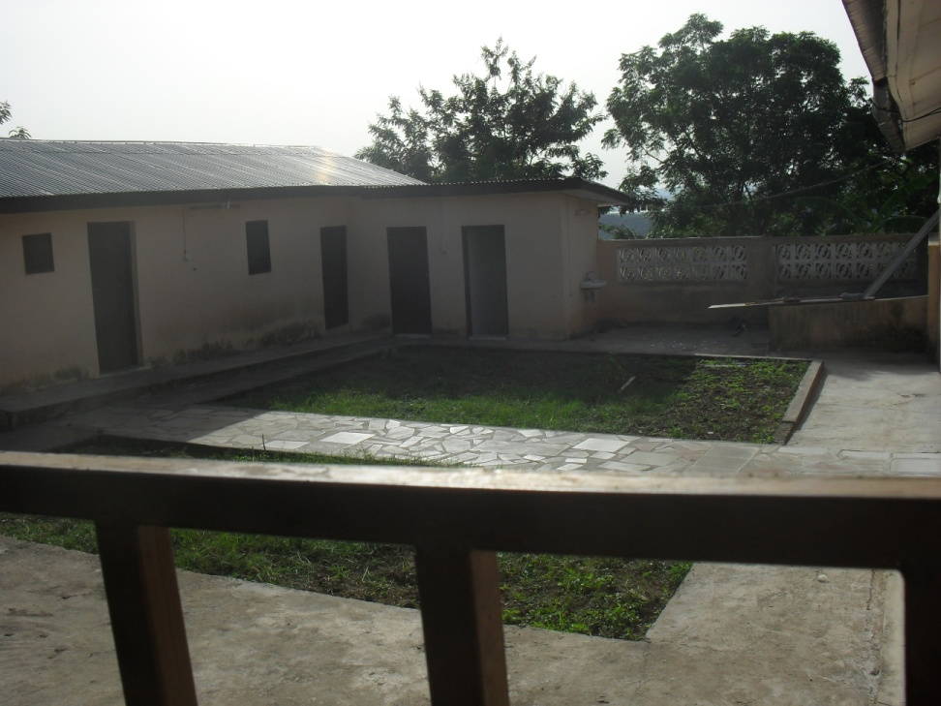
Other Scenes of the Finished Flooring

Slide 21
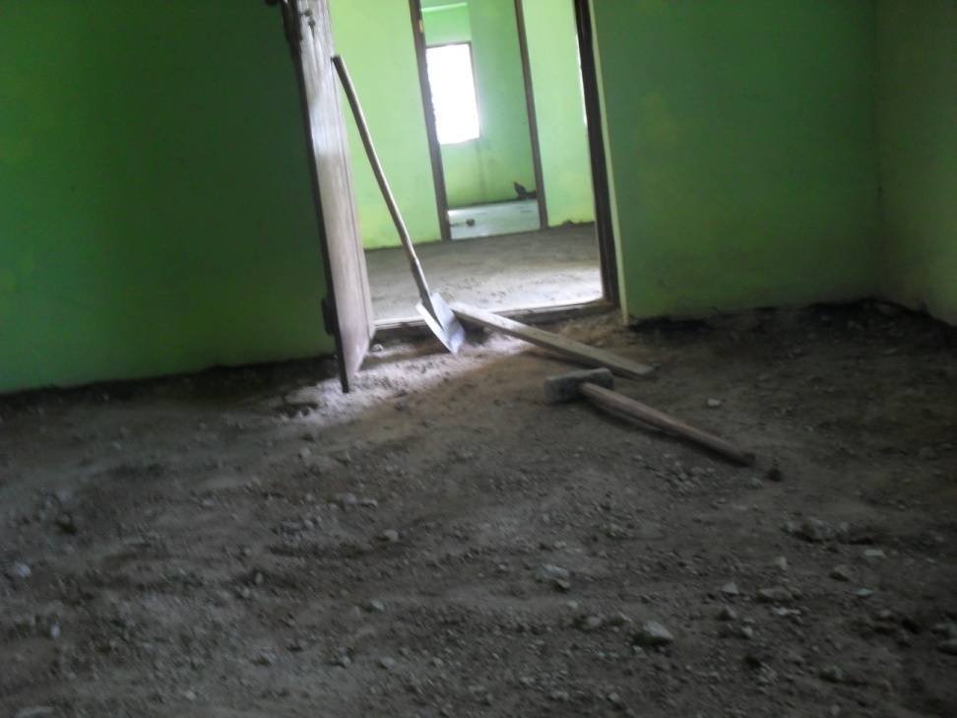
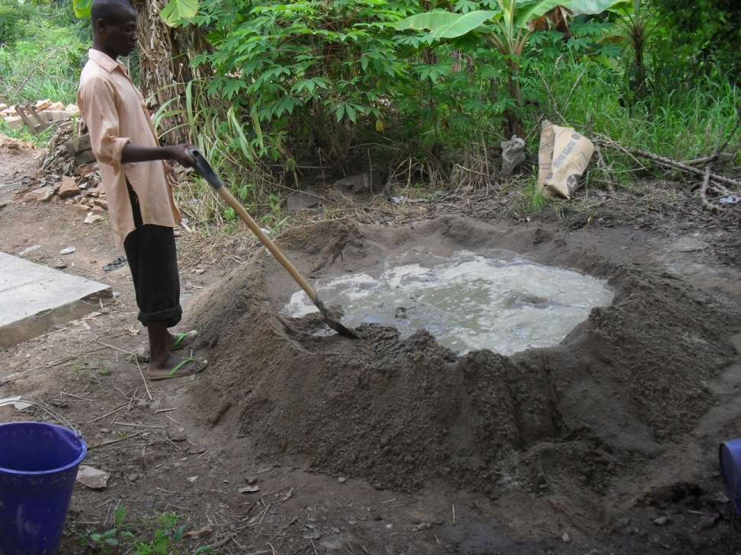
Tiling of Rooms I Director’s Home
Rooms before Tiling
Workman mixing mortar for work

Slide 22
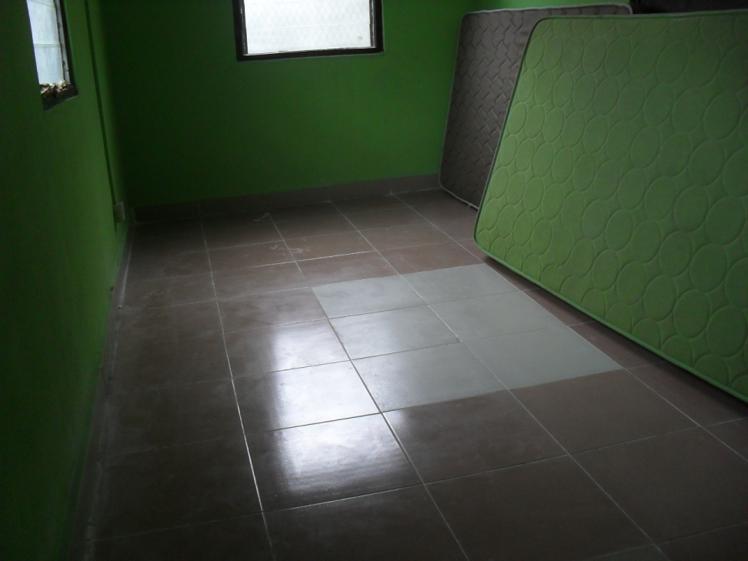
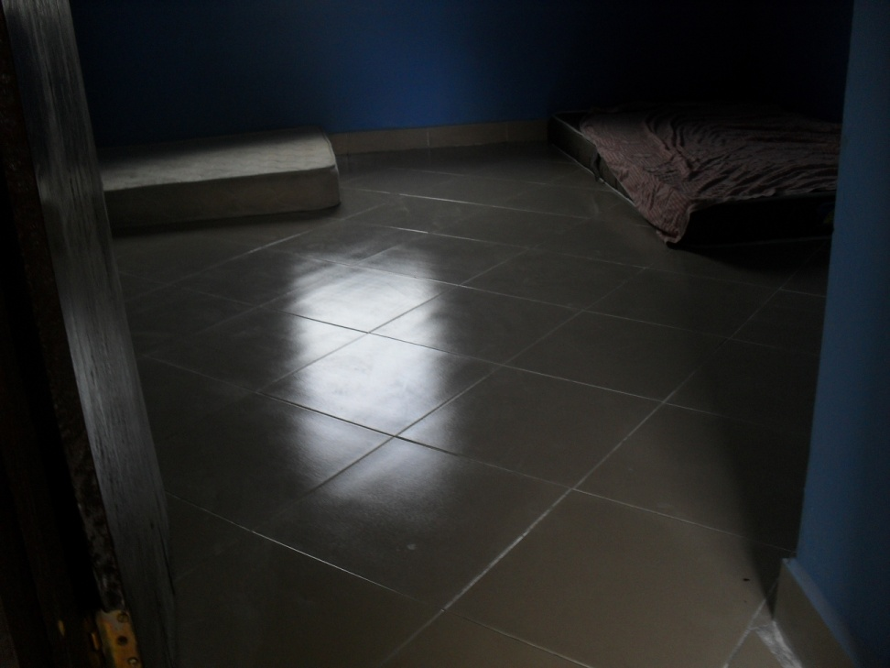
Some looks of the Tiled Rooms

Slide 23

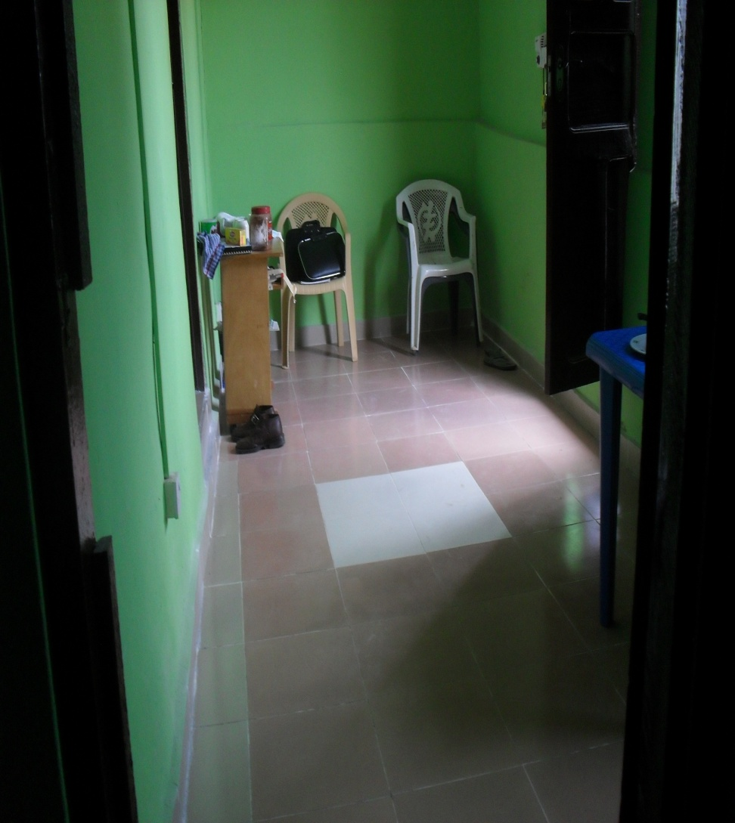
Other Looks

Slide 24
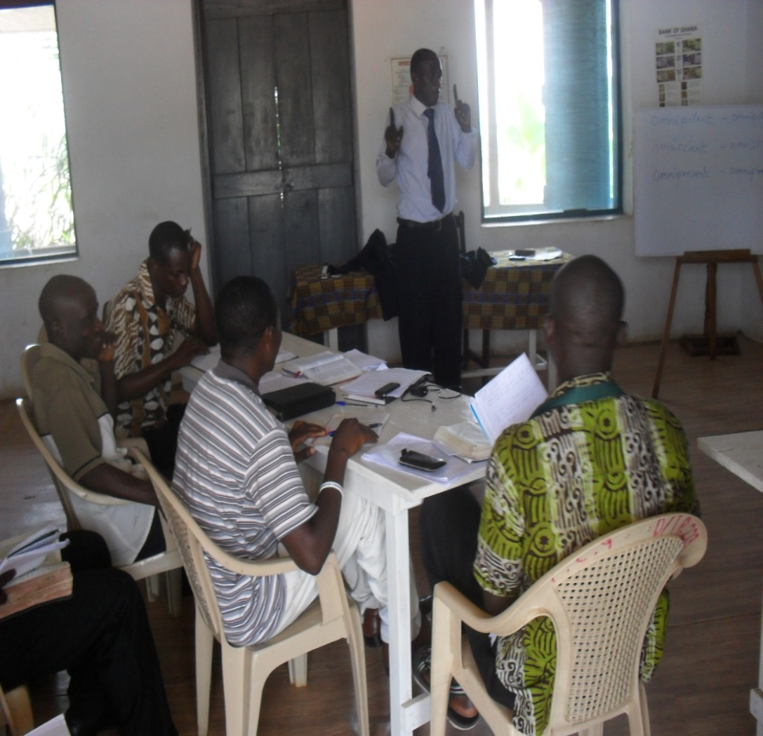
Programmes of the Centre
This preparatory course for Trinity and SMT aspirants was held at the Presbytery Conference Hall from 1st – 4th Dec. 2011 by Bana while preparing the Hilltop for immediate takeoff.

Slide 25
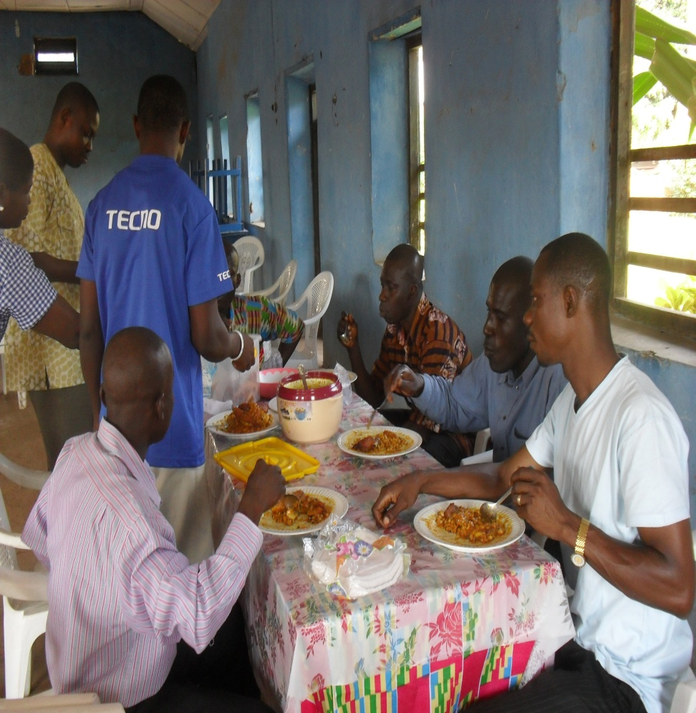
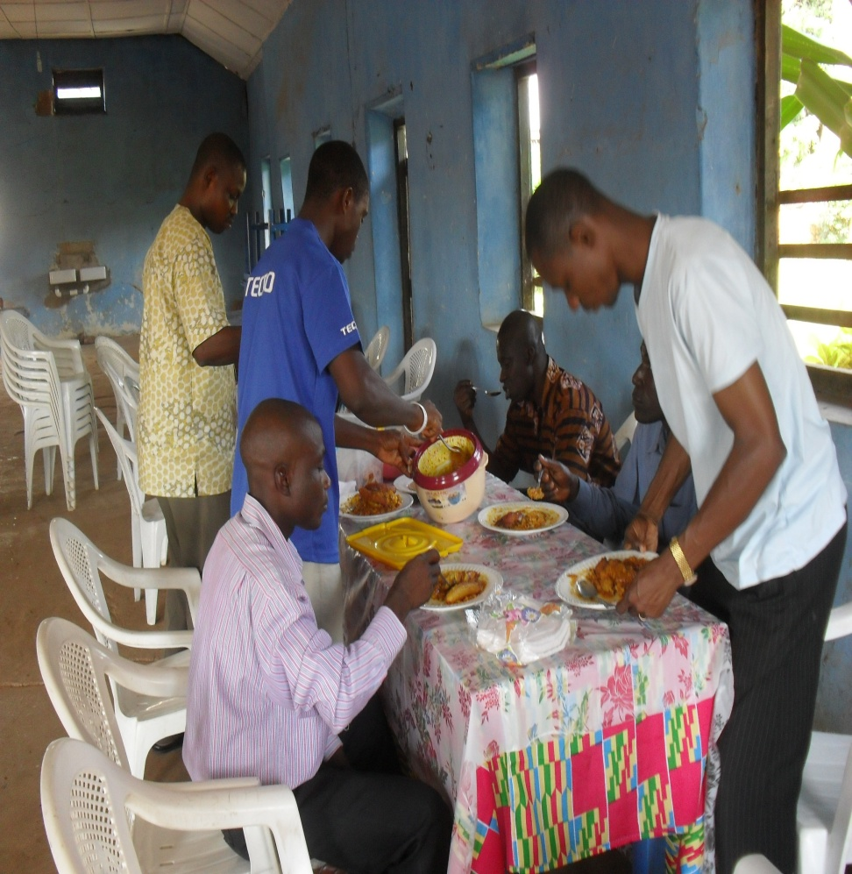
Participants of Exam Preparatory Course in Odumase at lunch.

Slide 26
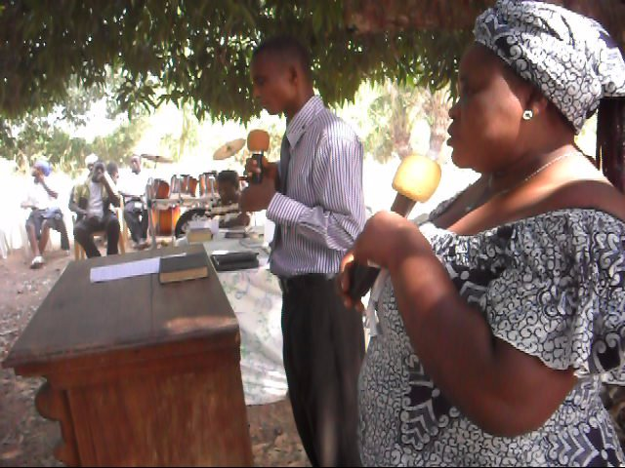
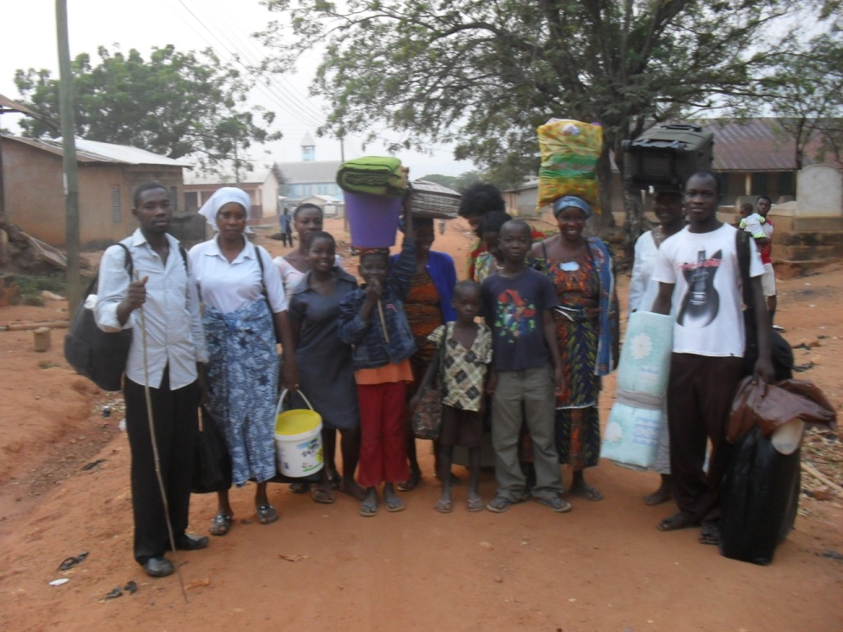
The Dangme-Tongu Presbytery Retreat at the Centre from 26th – 31st Dec. 2011
A Talk Session at Presbytery Retreat
Church members returning from the Retreat

Slide 27
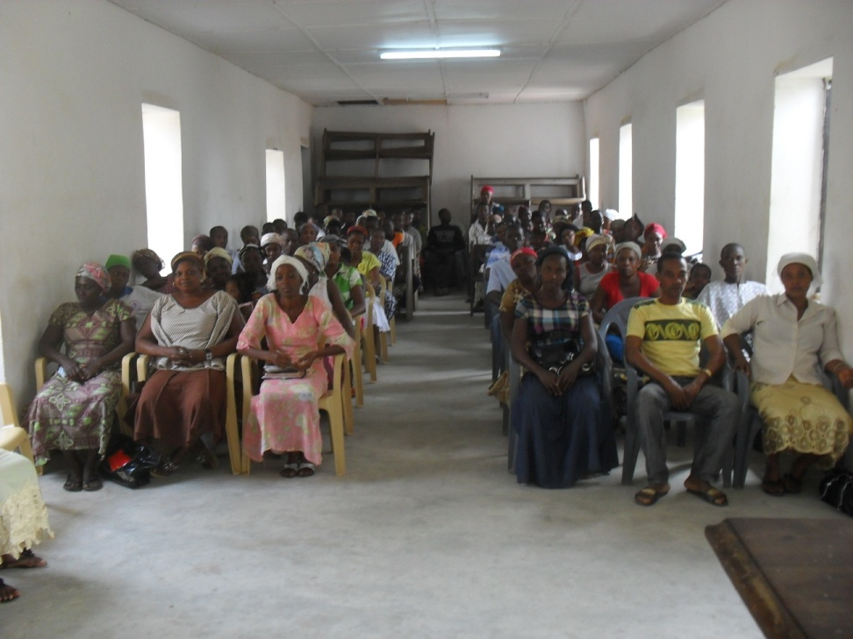
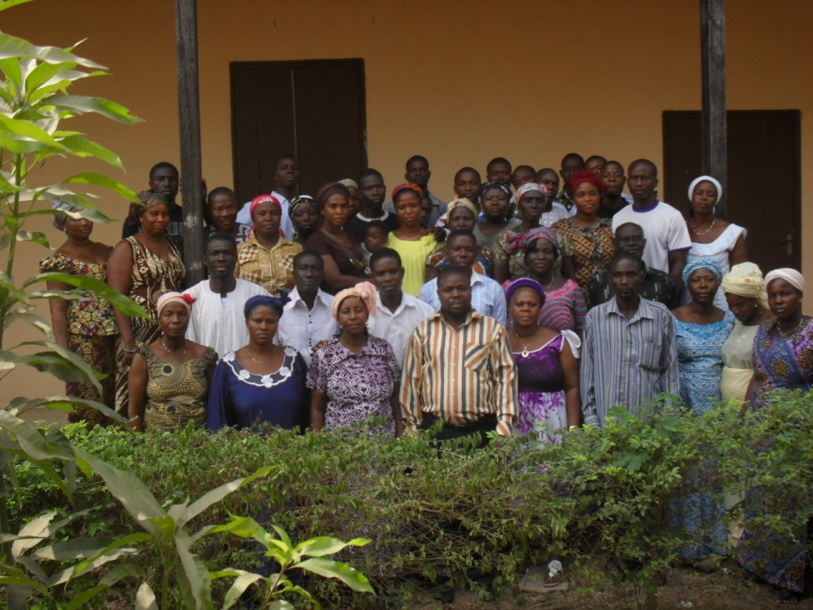
The Centre Hosted the House of Compassion Church Retreat in Jan. 2012
A talk Session at the House of Compassion Retreat
A group picture of participants at the House of Compassion Church

Slide 28
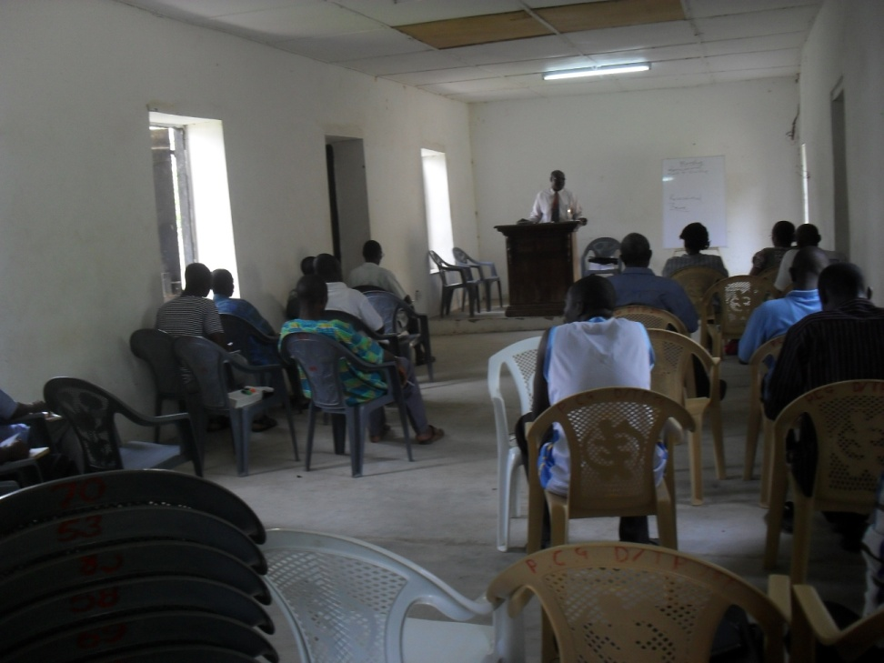
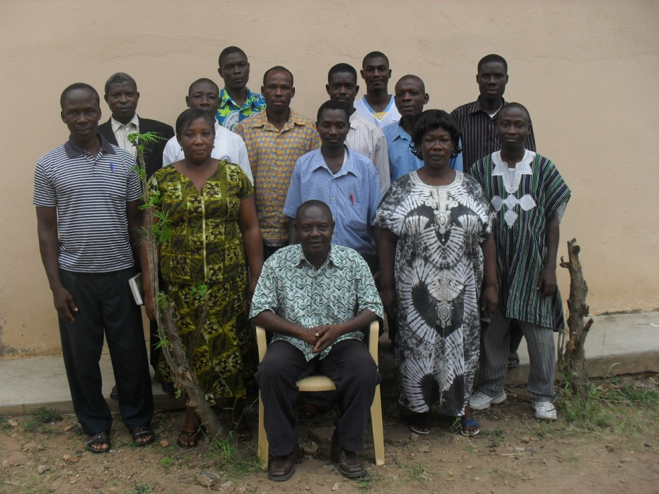
1st Catechists Refresher Course, 16th – 19th February 2012
A lecture Session at Catechist’s
Refresher Course wit Rev. E. T. Tekpertey
The Director (sitting) and some of the 17 Participants in a pose

Slide 29
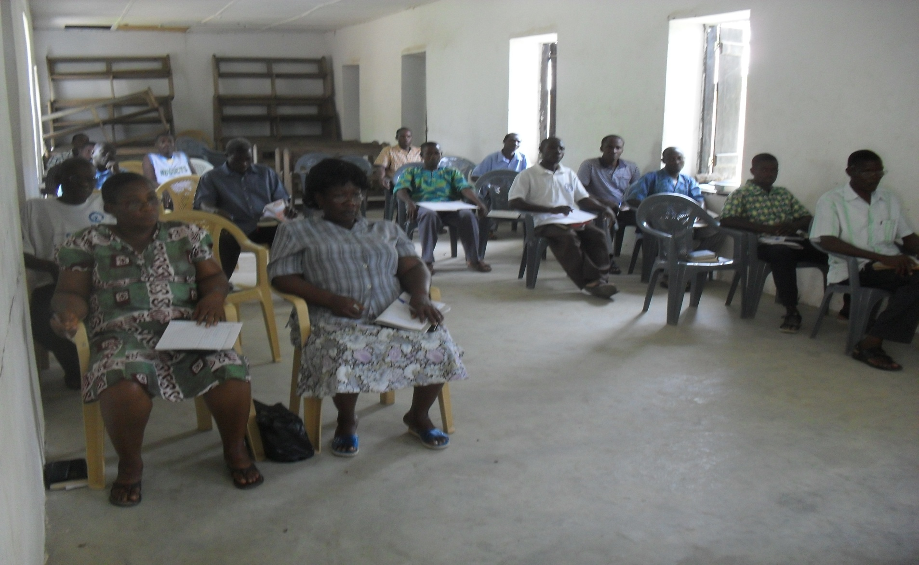
A class session at the Catechists’ Refresher Course – 16th – 19th Feb.

Slide 30
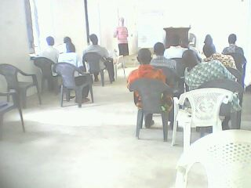

1st LMT Catechists’ Foundation Course at Bana, 28th April – 5th May 2012
A class session at the course
A group discussion session

Slide 31


LMT Foundation Course
Larisa (known as Ama in Ghana) teaching at the Foundation Course
Lecturers at the Catechists’ Foundation Course

Slide 32

Students and Lecturers in a pose after the Course

Slide 33

Script Marking Session after Foundation Course

Slide 34


Communal Work at Bana
Communal Work by Manyakpongunor District Youth
This Old Woman from the Manyakpongunor congregation took part in the work at Bana

Slide 35


Church Young People on voluntary work at Bana

Slide 36


The Director and the District Minister with the Young People at Work at Bana
Rev. E. O. Tettey, Director & Rev. (in red T-shirt & cup) Adzokatse Dist. Minister (in yellow T-shirt) sited in front
Work and happiness

